Slide 1
Scaled Agile Framework (or SAFe)

Slide 2
SAFe
Scaled Agile Framework (or SAFe) is an Agile software development framework designed by Scaled Agile, Inc. It consists of a knowledge base of integrated patterns intended for enterprise-scale Lean-Agile development. Its proponents consider SAFe to be scalable and modular, allowing an organization to apply it in a way that suits its need.
Notes:
SAFe synchronizes alignment, collaboration, and delivery for large numbers of agile teams. It supports both software and systems development, from the modest scale of under 100 practitioners to the largest software solutions and complex cyber-physical systems; systems that require thousands of people to create and maintain. SAFe was developed in the field, based on helping customers solve their most challenging scaling problems. SAFe leverages three primary bodies of knowledge: Agile development, Lean product development, and systems thinking. SAFe was initially developed in the field and was elaborated in Dean Leffingwell's books and blog. Version 1.0 of SAFe, the first official release, was published in its current web site form in 2011. The latest version renamed "SAFe 4.0 for Lean Software and Systems Engineering", was released in January 2016

Slide 3
SAFe Lean-Agile principles
1 - Take an economic view
2 - Apply systems thinking
3 - Assume variability; preserve options
4 - Build incrementally with fast, integrated learning cycles
5 - Base milestones on objective evaluation of working systems
6 - Visualize and limit WIP, reduce batch sizes, and manage queue lengths
7 - Apply cadence, synchronize with cross-domain planning
8 - Unlock the intrinsic motivation of knowledge workers
9 - Decentralize decision-making
Notes:
SAFe is bused on a number of immutable, underlying Lean and Agile principles. These are the fundamental tenets, the basic truths and economic underpinnings that drive the roles and practices that make SAFe effective. The nine principles are:
1 - Take an economic view
2 - Apply systems thinking
3 - Assume variability; preserve options
4 - Build incrementally with fast, integrated learning cycles
5 - Base milestones on objective evaluation of working systems
6 - Visualize and limit WIP, reduce batch sizes, and manage queue lengths
7 - Apply cadence, synchronize with cross-domain planning
8 - Unlock the intrinsic motivation of knowledge workers
9 - Decentralize decision-making

Slide 4








SAFe
Requirements
Design
Implementation
WATERFALL
Verification
4
444
:
Documents
Documents
Unverified System
System
Incremental
Delivery
Notes:
Here's a first look at the economics of Agile development. Specifically: Building incrementally accelerates value delivery.
Traditionally, we looked at things as a series of steps. Our traditional waterfall life cycle had us doing what made sense: We did our requirements, our design, our implementation, and our verification—in that order. It's hard to argue with that; you couldn't do the implementation before you did the requirements, for example.
But we've learned a few things in the last couple of decades, and we now understand that it's possible—with the right constructs, the right thinking, and the right culture—to develop and deliver incrementally….
…. that's the basic nature of Agile and Lean development, as compared to our traditional development models.

Slide 5
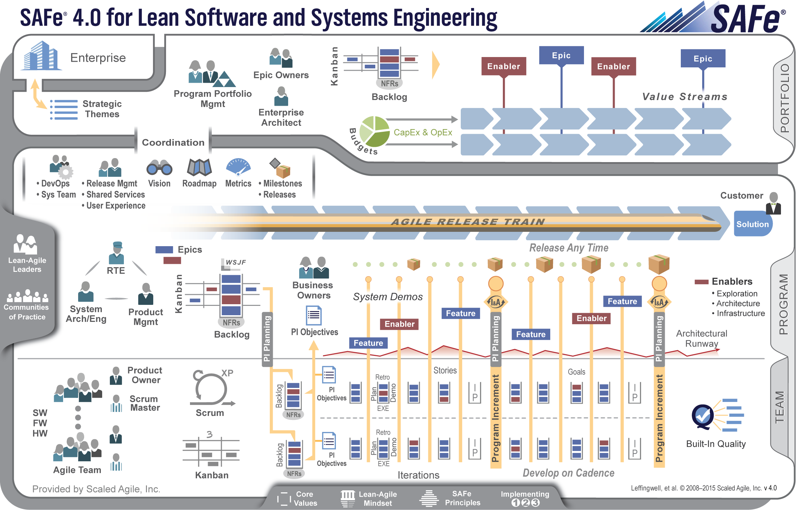
Three-level SAFe 4.0
Notes:
You can see that it's organized around teams—teams are the fundamental construct. Teams are the goose that lay our Agile golden egg, and we want to create teams and help them be and stay incented to do their best work.
The Program Level, where a group of Agile Teams work together to deliver a larger solution, is indicated here.
And of course the Customer is part of our Solution.
This larger structure in the middle is the Agile Release Train, which I'll come back to in a second. The Agile Release Train is the organizational construct—typically virtual—that delivers solutions.

Slide 6
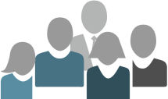
Applies test automation
Test automation supports rapid regression testing
Test 1
Test 2
Test 3
Test 4
Test 5
…
Test 1
Test 2
Test 3
Test 4
Test 5
…
Implemented in the same iteration
Maintained under version control
Passing vs. not-yet-passing and broken automated tests are the real
iteration progress indicator
✗
Progress
Done
Building functionality
Test automation
Iteration
Notes:
Agile teams apply test automation, and that supports rapid regression testing.
Why do we need that?
Because when we're providing these basic cycles, each time we make a change we have to make sure that the system still works. Some degree of test automation is going to be mandatory for that.
The tests need to be implemented in the same iteration as the code.
Tests are maintained under version control; they're part of your system.
Passing and not-passing tests are the real progress indicators.

Slide 7
Team
Cross-functional, self-organizing entities that can define, build and test a thing of value
Applies basic scientific practice: Plan—Do—Check—Adjust
Delivers value every two weeks
Do
Check
Adjust
Plan
PDCA
Notes:
It all starts with the Agile Team.
They're cross-functional, largely self-organizing, and largely self-managing.
They can define, build, and test a thing of value. They apply that basic scientific practice in what we call iterations, or sprints: plan, do, check, adjust.
They do that on a cadence, they do it frequently, they do it routinely. Really, that's all they do; that is their development model. Plan, do, check, adjust, and deliver value every two weeks.

Slide 8
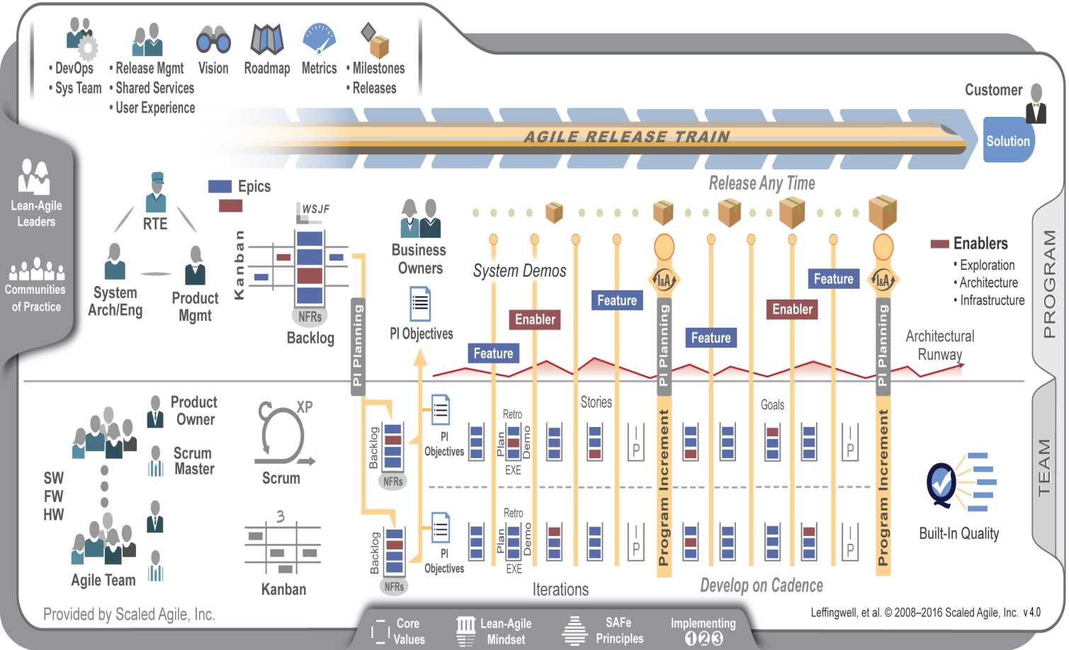
Agile Teams
Align 50-125 practitioners to a common mission
Apply cadence and synchronization, Program Increments every 6-12 weeks
Provide Vision, Roadmap, architectural guidance
Notes:
They work together and take an approach that says, "Let's take these plan-do-check cycles, and let's accumulate those into larger cycles."
We call this the Agile Release Train.
The Agile Release Train aligns 50 to 125 practitioners to a common mission.
We apply cadence and synchronization, program increments every 6 to 12 weeks. So these sprints, or iterations in SAFe, add up very quickly into larger amounts of value.
We provide vision, roadmap, and architectural guidance. There may be 10 or 15 teams on this train.
For example: Let's say we're going to implement single sign-on…. We need to decide how to do that, and we want everybody to do it the same way to make sure that we don't introduce security holes in our single sign-on mechanism.

Slide 9
Levels
There are two different types of SAFe 4.0 implementation, 3-Level SAFe and 4-Level SAFe. 3-Level SAFe is for smaller implementations with 100 people or less, or multiple such programs that do not require significant collaboration. 4-Level SAFe is for solutions that typically require many hundreds of practitioners to develop, deploy and maintain.
The levels in 3-Level SAFe are Team, Program & Portfolio.
Notes:
For those of you building systems of modest scale—maybe systems or software products that you can build with 30 to 50 practitioners, or those without a lot of dependencies between them—what we’ve shown you so far are all you need: the team, the program, the Portfolio Level.
But when you hit this "expand" button shown here, you’ll get a 4th level. The Value Stream Level.
And this is designed for people designing really big systems, high-assurance systems, cyber-physical systems, trading systems.
These are systems that require hundreds and hundreds of people and typically many types of subsystems in order to build the larger solution.

Slide 10
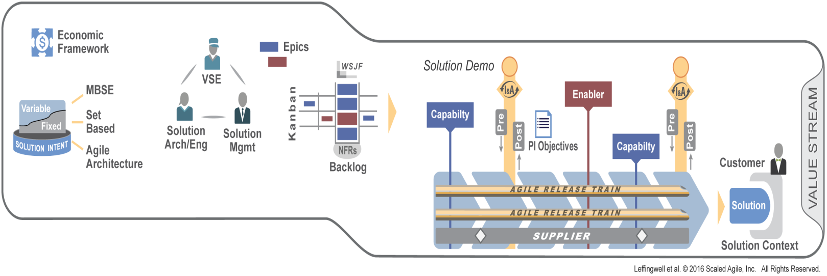
New 4.0 Value Stream level
Apply cadence and synchronization
Establish local governance with Value Stream roles and Economic Framework
Manage fixed and variable Solution Intent
Manage the flow of Capabilities with the Value Stream Kanban
Frequently integrate and validate Customer solutions
Notes:
So let's look at the Value Stream Level in a little more detail. Of course we apply cadence and synchronization—we always do. We use the same PI schedule that we did before. But now we're thinking about the fact that the individual trains work together to deliver the larger solution.
We need to establish some governance with Value Stream roles and an Economic Framework. Those are deep articles on the site that you can dive into at your leisure.
We manage what we call fixed and variable Solution Intent. So now we introduce the notion of the solution itself. Earlier we had stories and features—we didn't talk about them much, but we weren't overly concerned about that.
But now we really do have to know exactly what this system does at all times. And we manage the flow of capabilities with the Value Stream Kanban—similar to the Portfolio Kanban. And again, we integrate frequently. Deliver continuously.
We frequently integrate and validate customer solutions.

Slide 11
Results
Happier, more motivated employees
30 – 75% faster time to market
ENGAGEMENT
TIME TO MARKET
PRODUCTIVITY
BUSINESS RESULTS
QUALITY
20 – 50% increase in productivity
50%+ defect reduction
Notes:
You'll get results like these:
Happier, more motivated employees
30 to 75% faster time to market
50%-plus defect reduction, and a
20 to 50% increase in productivity.
These are some pretty impressive results results and may sound like something that’s tough to believe or marketing hyperbole…..

